Slide 1
CRICKET SCORE CARD SYSTEM
CHITRIKI GANESH- 3BR19CS040
TUSHAR TELKAR- 3BR19CS168
VARUN G- 3BR19CS174
VENU GOPAL REDDY M- 3BR19CS178

Slide 2
INTRODUCTION
The project entitled "cricket score card system" which is utilized by the user with an update of the cricket score even when the user is not watching the match.
In this project a coin will be tossed. Team can choose either head or tail. Then all the activities of players such as bowling and batting are done.
The team which is coming to bat should enter the number of overs.
The team which has choosen batting will play first then further bowling team will play the match.
All the activities are recorded such as players score, runrate per over, number of boundries, team score after each over and number of balls played by each player.
Then scoresheet is displayed after each over. Then finally innings scoresheet is displayed after each innings. Then the team which has won the match will be displayed.

Slide 3
VISION, MISSION AND OBJECTIVES
VISION: To design and develop a cricket scorecard system project in C++.
MISSION: To ensure that the live cricket match score is to be showed without any delay.
OBJECTIVES:
User have to choose the toss head or tail.
Who wins the toss have to choose batting or bowling.
Then user have to input overs.
Then the cricket score card system is generated automatically.

Slide 4
SYSTEM ANALYSIS AND REQUIREMENTS
HARDWARE REQUIREMENTS
PC
PROCESSOR: Pentium IV/Dual core/Core duo processors
RAM: 2GB/4GB/8GB and above
HARD DISK: 1TB and above
SOFTWARE REQUIREMENTS
OPERATING SYSTEM: WINDOWS XP/7/8/10 or LINUX
SOFTWARE: VISUAL STUDIO CODE, DEV C++
PROGRAMMING LANGUAGE: C++

Slide 5
FUNCTIONAL REQUIREMENTS
TOSS
Team players details
Cricket match

Slide 6
NON FUNCTIONAL REQUIREMENTS
PERFORMANCE REQUIREMENTS: The database shall be able to accommodate a minimum of 10,000 records of students. The software shall support use of multiple users at a time. There are no other specific performance requirements that will affect development.
SAFETY REQUIREMENTS: The database may get crashed at any certain time due to virus or operating system failure. Therefore, it is required to take the database backup.
SECURITY REQIREMENTS: Some of the factors that are identified to protect the software from accidental or malicious access, use, modification, destruction, or disclosure are described below. Keep specific log or history data sets assign certain functions to different modules restrict communications between some areas of the program check data integrity for critical variables later version of the software will incorporate encryption techniques in the user/license authentication process.

Slide 7
DOMAIN REQIREMENTS
TOSS: In this module a coin will be tossed. Team can choose either head or tail. The team which has won the toss can choose either batting or bowling.
TEAM PLAYERS DETAILS: In this module the details of players with respect to their teams are displayed.
CRICKET MATCH: This is the main module of our project, in which, all the activities of players such as bowling and batting are done. The team which is coming to bat should enter the number of overs. Then the match gets started, with respective overs mentioned above. The team which has choosen batting will play first then further bowling team will play the match. All the activities are recorded such as players score, runrate per over, number of boundries, team score after each over and number of balls played by each player. Then scoresheet is displayed after each over. Then finally innings scoresheet is displayed after each innings. Then the team which has won the match will be displayed.

Slide 8
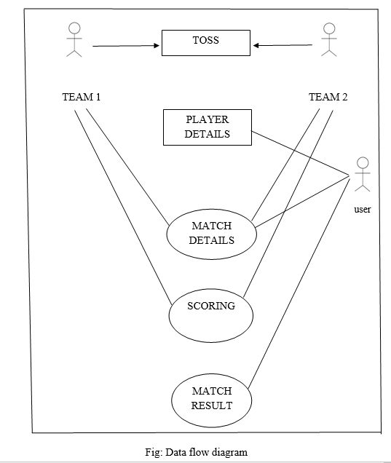
SYSTEM ARCHITECTURE DESCRIPTION
DATA FLOW DIAGRAM

Slide 9
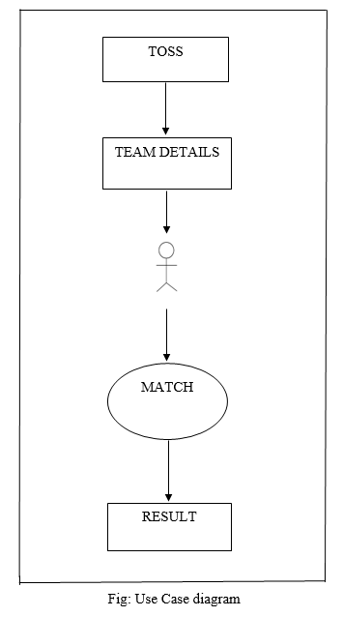
SYSTEM ARCHITECTURE DESCRIPTION
USE CASE DIAGRAM

Slide 10
CONCLUSION
It is concluded that the application works well and satisfy the end users. The application is tested very well and errors are properly debugged. The application is simultaneously accessed from more than one system. Simultaneous login from more than one place is tested. This system is user friendly so everyone can use easily. Proper documentation is provided. The end user can easily understand how the whole system is implemented by going through the documentation. The system is tested, implemented and the performance is found to be satisfactory. All necessary output is generated. Thus, the project is completed successfully. Further enhancements can be made to the application, so that the application functions very attractive and useful manner than the present one.

Slide 11
REFERENCES
Cricbuzz
ESPN cricinfo
Cricket exchange
Cricket line guru
Cricket connected live cricket score app

Slide 12
Thank You

